Slide 1
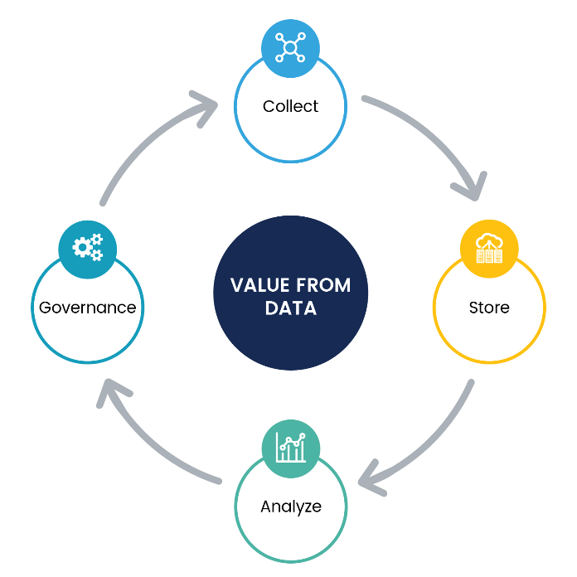
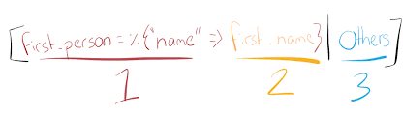
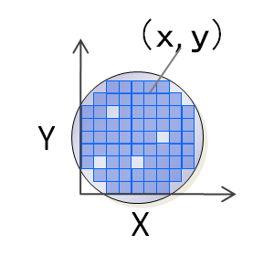
Pattern Matching From Silicon to Software
soundararajan

Slide 2


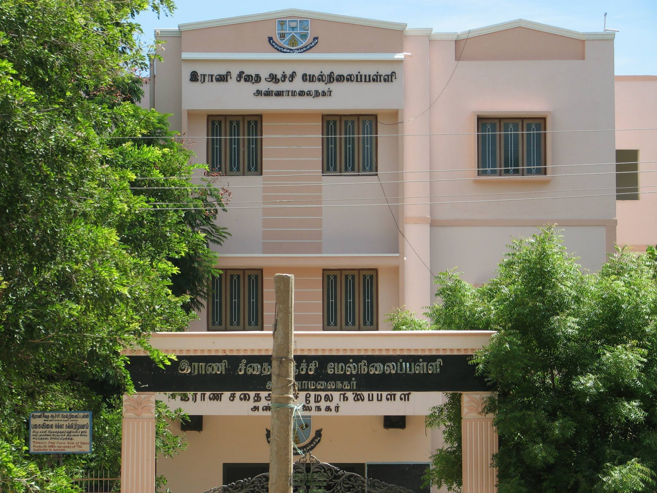
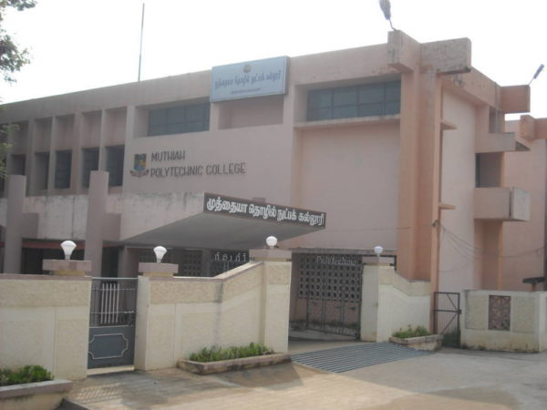


About me

Slide 3


Agenda
Philosophy of Pattern matching
Silicon
Pattern matching in Silicon wafer inspection
Software
Pattern matching in Healthcare
In Practice
Algolia structural pattern matching
MongoDB, MapReduce
Stanford NLP library for Grammatical Inference
Q & A

Slide 4
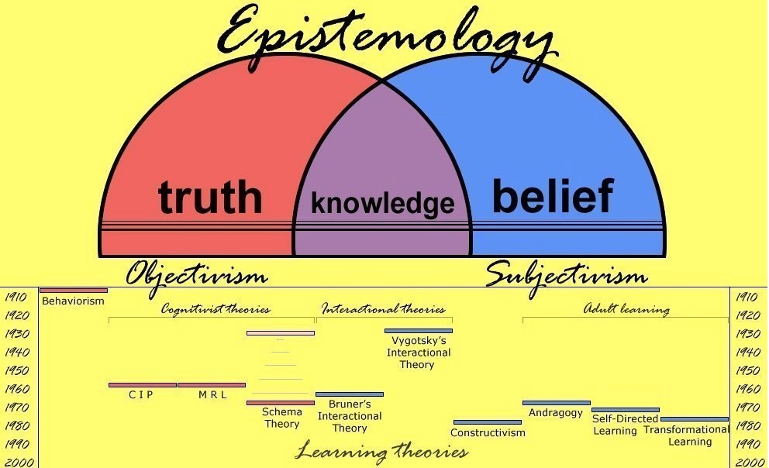
Philosophy of Pattern Matching

Slide 5



Silicon Wafer Manufacturing
Click above to start the video

Slide 6
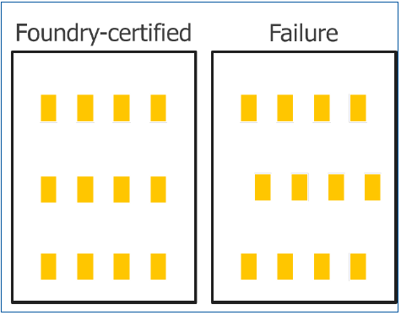
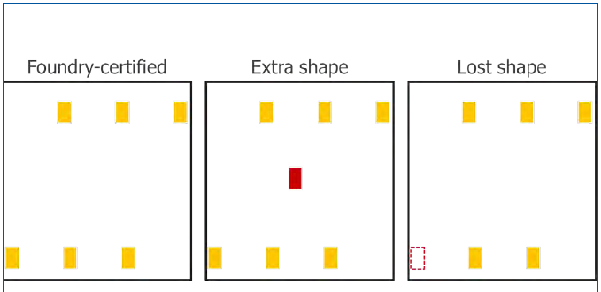
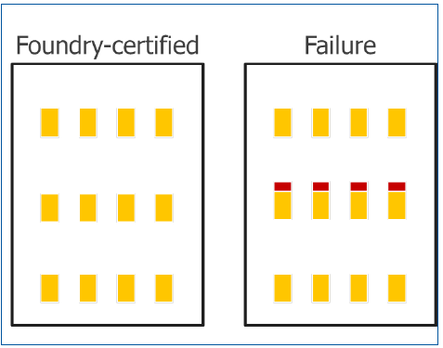
The problem
Shape shifting
Extra / Fewer Shapes
Shapes change

Slide 7
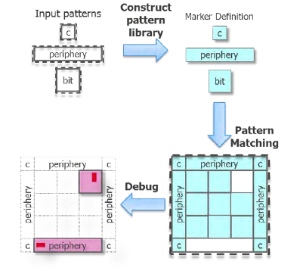
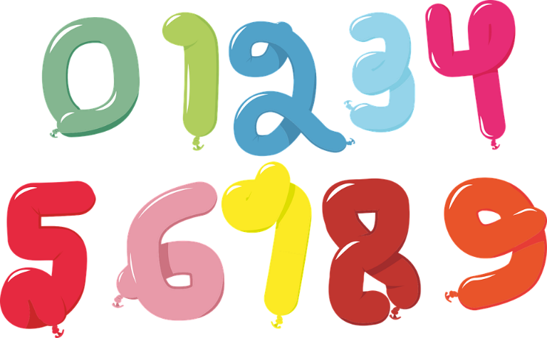



The Solution

Slide 8

The role of pattern matching

Slide 9
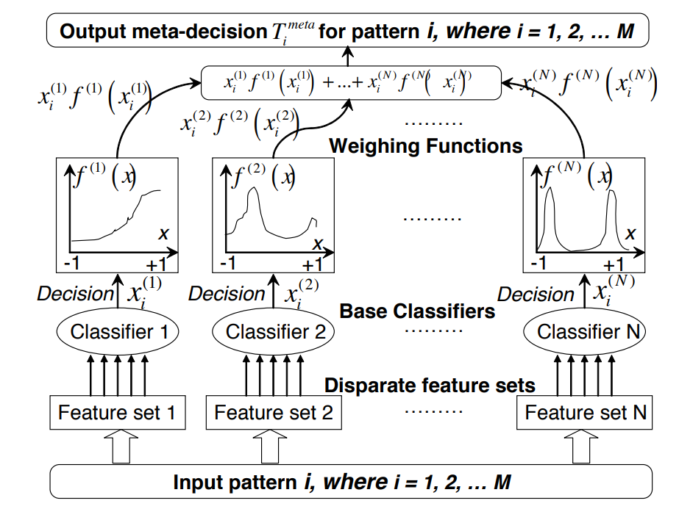
Some details in implementation

Slide 10
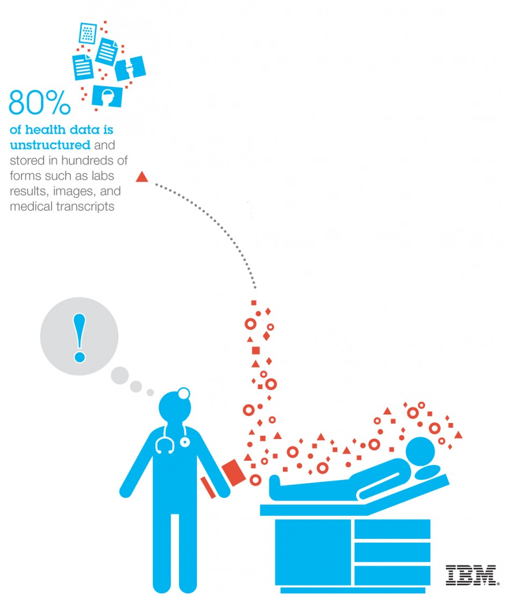


Pattern Matching in Healthcare
The Problem
The Solution

Slide 11

A note on SQL and noSQL
SQL Server provider table (but not necessarily bad)
Not usable for BigData operations because of referential constraints and schema oriented CURD operations.
Mongo DB provider table (but not necessarily the greatest)
No discipline on CURD operations
Key, Value pair.
Flexible for unorthodox operations.

Slide 12
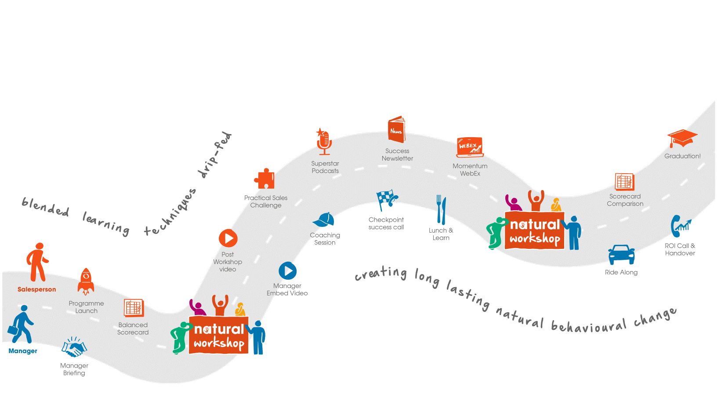
Different Approaches
Idealistic
Expert systems
Belief networks
Probabilistic networks
Spiritualistic
Syntactic pattern recognition
Structural pattern recognition
AI
Materialistic
Neural Networks Vision
Realistic
Grammatical Inference
Machine Learning
Grammatical Inference
Structural Pattern Recognition

Slide 13
Structural Pattern Recognition
Text matching for providers
Search for AUDREY WAROLIN in conventional database (link)
Search the same with Algolia (link)
Typo tolerance
Synonyms
Query Rules

Slide 14
Using BigData, NoSQL , MongoDB
Find the provider information by state
Discuss the problems with the data, why pattern matching is required
Find the number of Male and Female providers in US (Clustering)
Issues with data
Conditions on Entity Types
Results

Slide 15
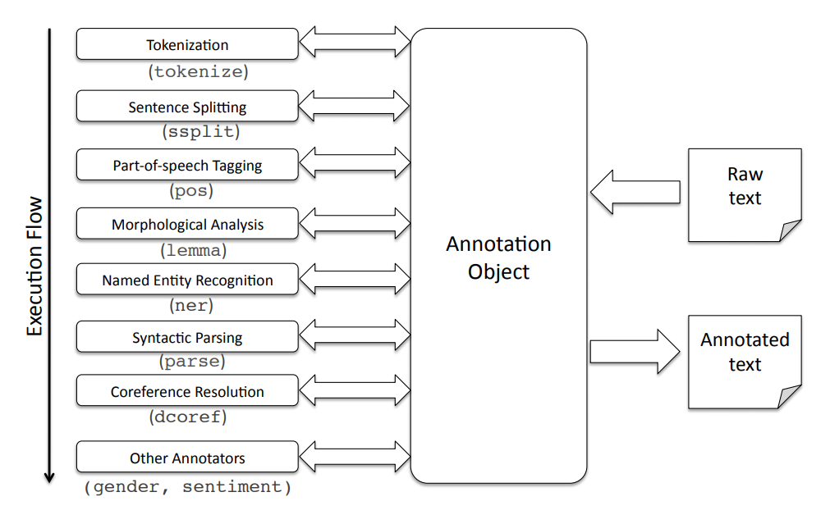
Stanford CoreNLP
Parts-of-speech Tagging
Named Entity Recognition

Slide 16
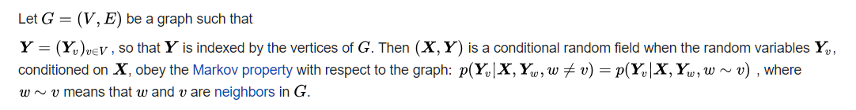
Named Entity Recognition
Implementation of (arbitrary order) linear chain Conditional Random Field (CRF) sequence models for structured prediction.
CRF can take context into account
Named Entity Recognition Demos(ner)
Names
US States
Date

Slide 17
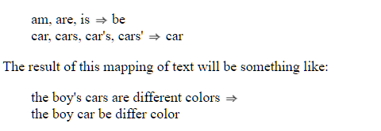
Parts of Speech Tagger
Implementation of Log Linear POS tagger.
Plenty of memory is needed to train a tagger. at least 1GB is usually needed.
The English taggers use the Penn Treebank tag set.
Lemmatization
Demo
http://corenlp.run/

Slide 18



Questions
http://soundararajan.in
soundararajan@outlook.com
twitter.com/soundararajan

